Slide 1







CREDIT CARD DELINQUENCY WATCH
A Lightweight Rule-Based System for Early Delinquency Detection
Prepared by :
Aminul Islam
Roll No: GA.09
Gauhati University
HDFC Campus to Corporate

Slide 2
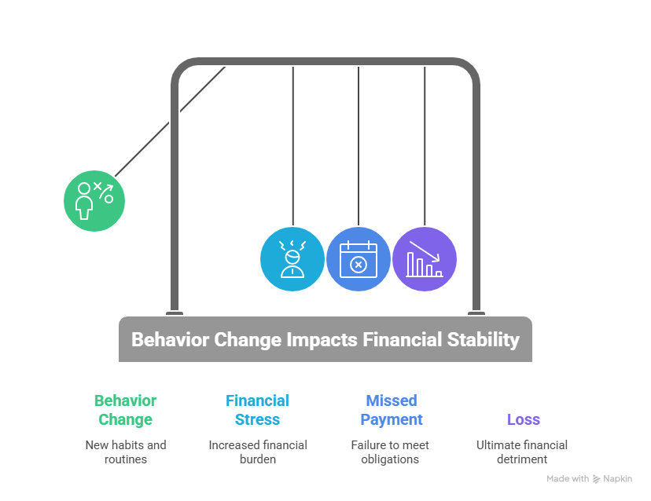
Problem Understanding
Why Early Delinquency Detection Matters
Banks often detect risk after missed payments occur
Subtle behavioral changes appear weeks before delinquency
Traditional systems rely on lag indicators like DPD
Missed early-warning signals lead to higher roll-rates
Need a lightweight, proactive system to flag early risk
GOAL:
👉 Detect high-risk customers before they miss payments

Slide 3
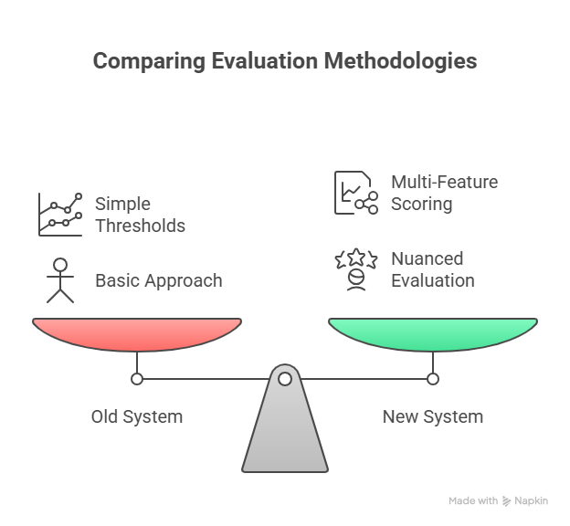
Why Traditional Systems Fail
Limitations of Current Risk Monitoring
Rules often depend only on DPD or repayment history
No combined view of spending + repayment + utilization behavior
Lack of interpretability → collections teams cannot understand why risk was assigned
Outreach becomes reactive, not preventive
No personalized interventions to prevent roll-rates

Slide 4
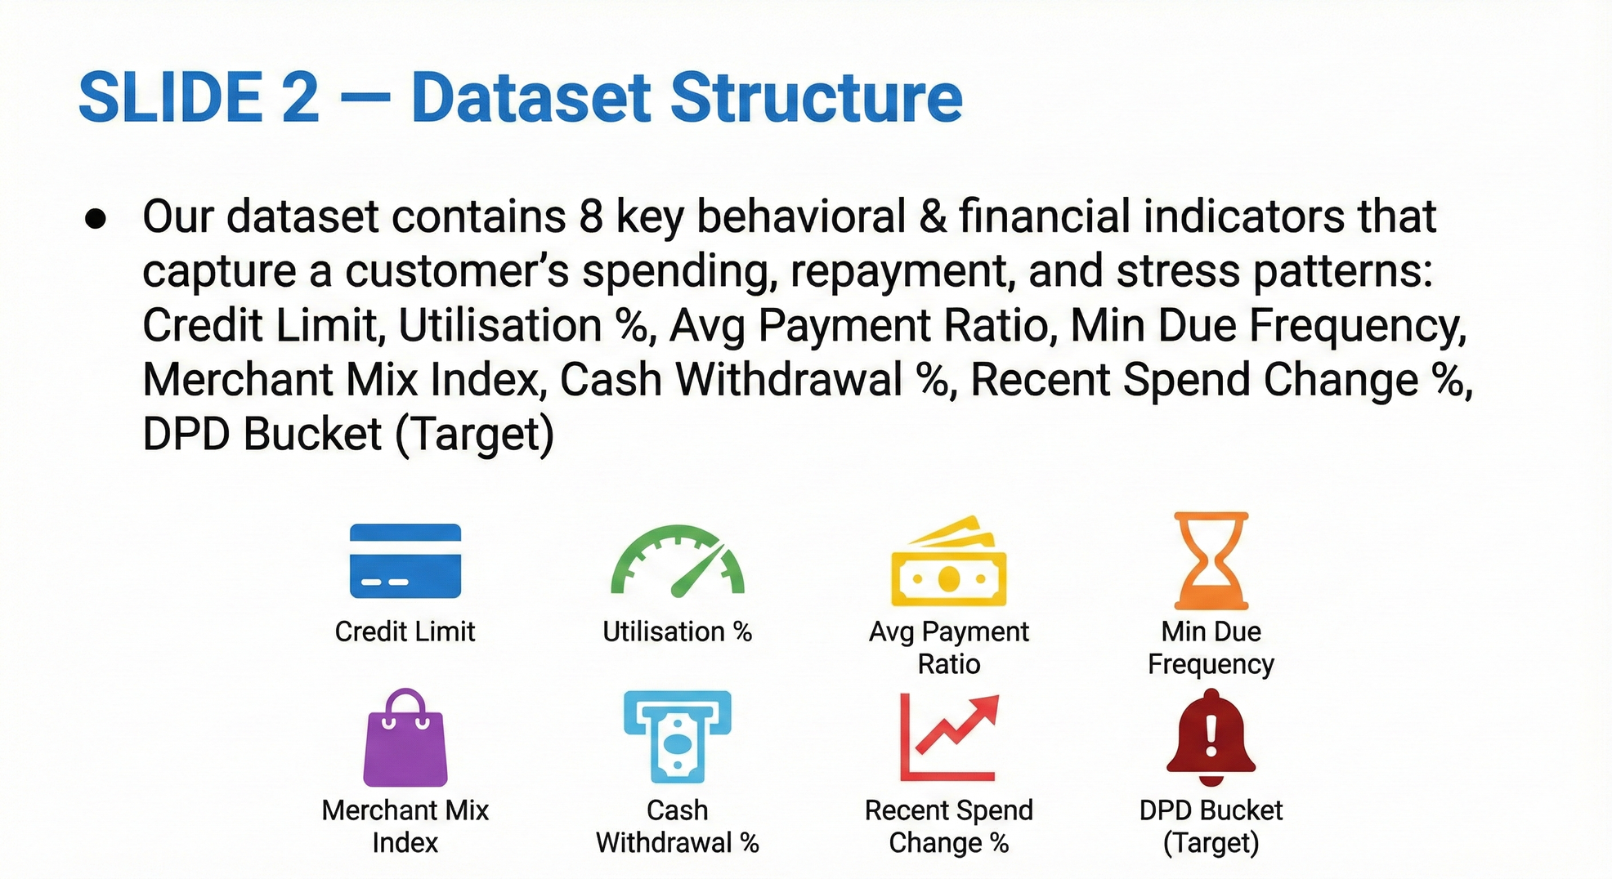
Dataset Overview (EDA Input)
Understanding the Dataset
2,500 customer accounts- Real + Synthetic
Behavioral + repayment + utilization features
Includes next-month delinquency outcome (DPD bucket)

Slide 5
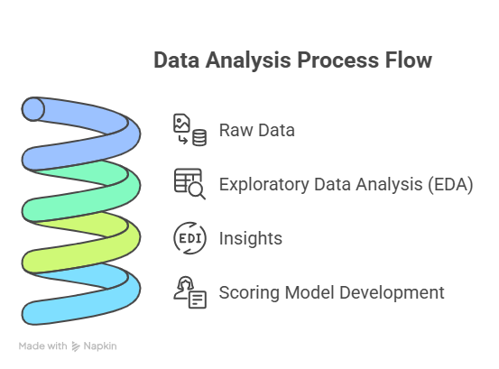
EDA Objective
Why Perform EDA?
Understand customer behavior patterns
Detect hidden trends linked to delinquency
Validate assumptions from problem brief
Identify features for scoring engine
Separate leading indicators from lag indicators

Slide 6
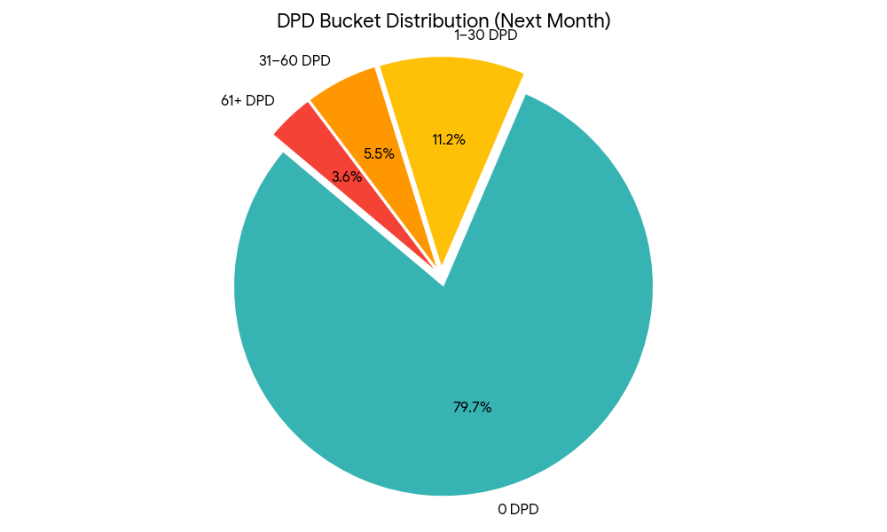
EDA Visual 1: DPD Distribution
Most customers are current, but a meaningful portion fall into early delinquency buckets — validating the need for early-risk detection.

Slide 7
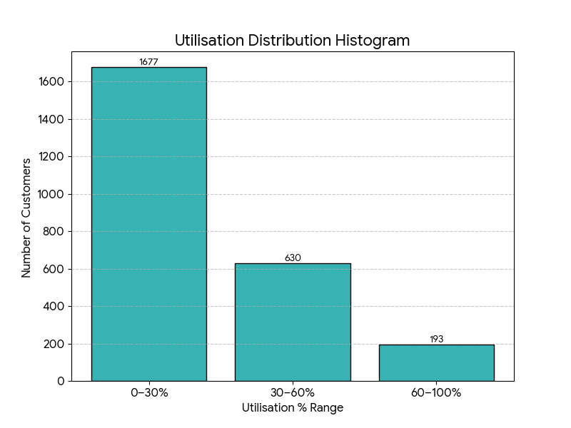
EDA Visual 2: Utilisation Distribution
Higher Utilisation % groups show more stress behavior and correlate with future delinquency.

Slide 8
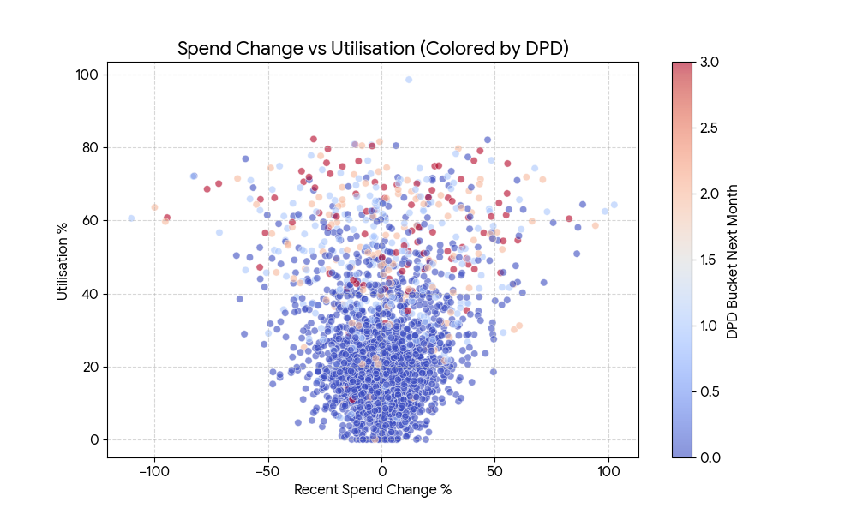
EDA Visual 3: Spend Change vs Utilisation
Sudden change in monthly spend combined with high utilization is a strong predictor of delinquency.

Slide 9
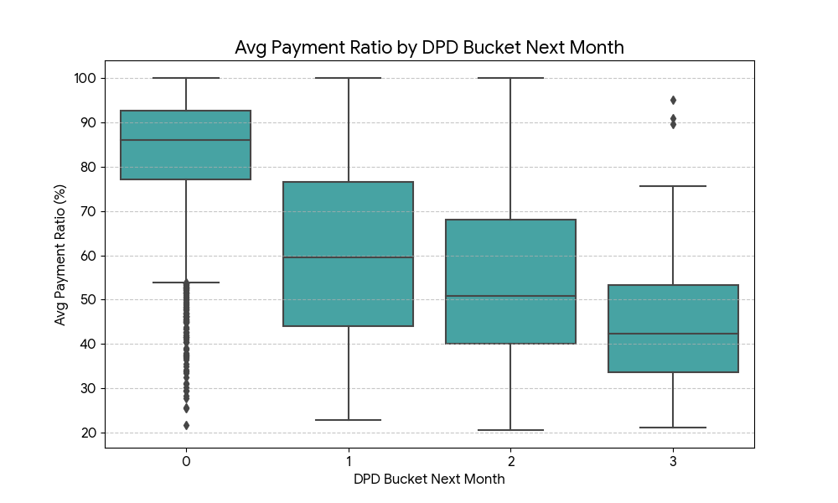
EDA Visual 4: Avg Payment
Ratio by DPD
Customers who become delinquent next month generally pay a lower % of their total due over the previous 3 months.

Slide 10
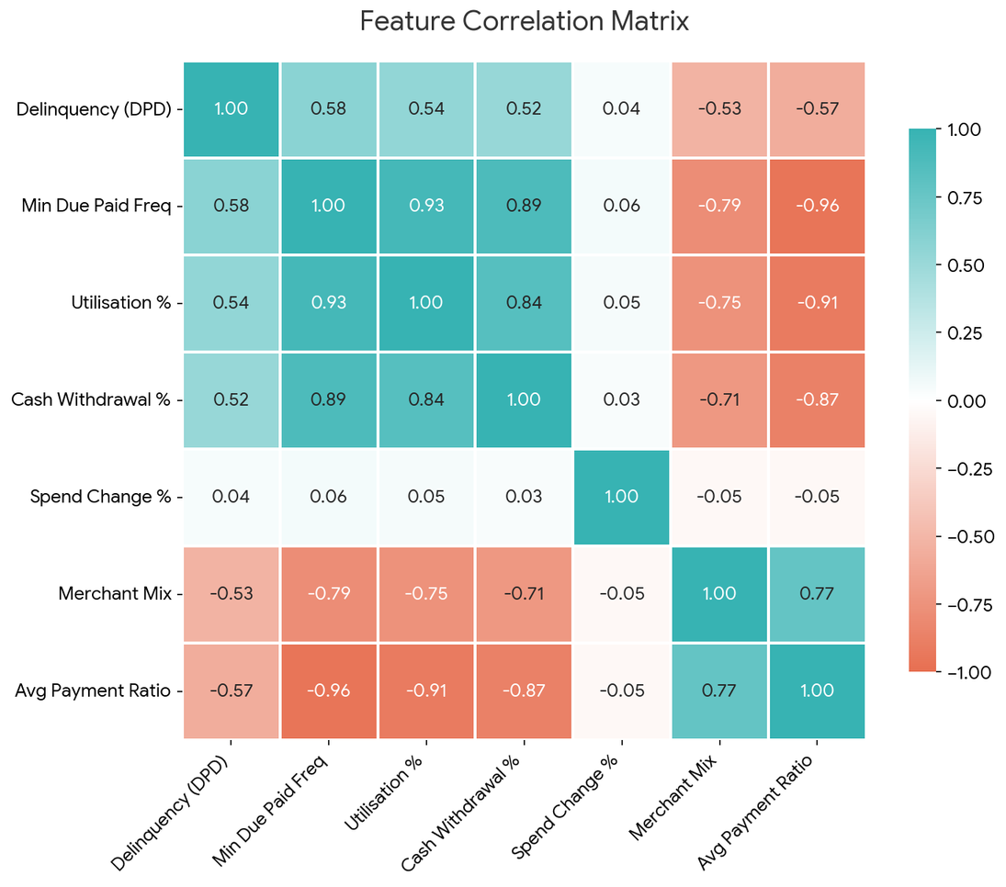
EDA Visual 5: Feature Correlation Heatmap
Key Insights
Top Predictors:
Min Due Paid Frequency (+0.58) and Avg Payment Ratio (−0.57) show the strongest relationship with delinquency.
Feature Interaction:
Utilisation % and Min Due Paid Frequency have a very high correlation (+0.93), indicating heavy users often pay only the minimum.
Weak Predictor Alone:
Recent Spend Change % shows almost no direct correlation with delinquency, but becomes meaningful only when combined with high utilisation.

Slide 11
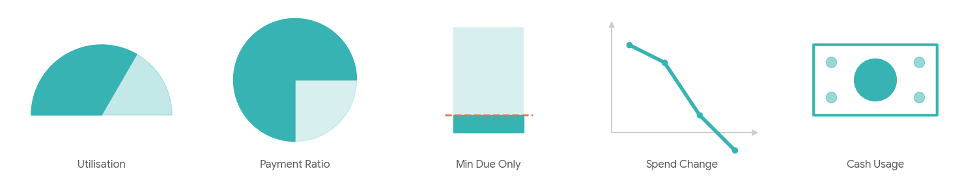
EDA Summary
Summary of EDA Findings
Delinquent customers exhibit clear behavioral patterns different from non-delinquents
Min Due Paid Frequency, Avg Payment Ratio, and Utilisation % emerge as the strongest predictors
Cash Withdrawal % and Spend Change % show early financial stress signals
EDA confirms that early risk indicators appear before DPD rises
These insights form the foundation of our scoring engine design

Slide 12
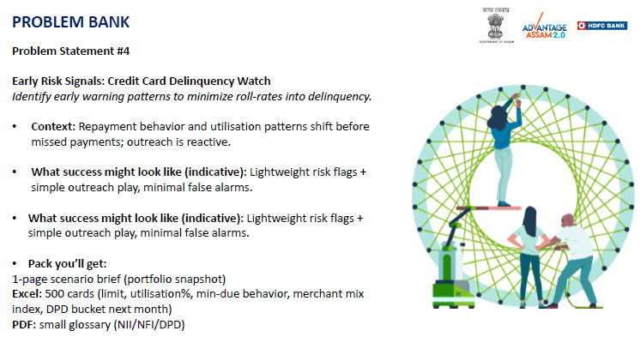
Original Problem Statement from Bank

Slide 13
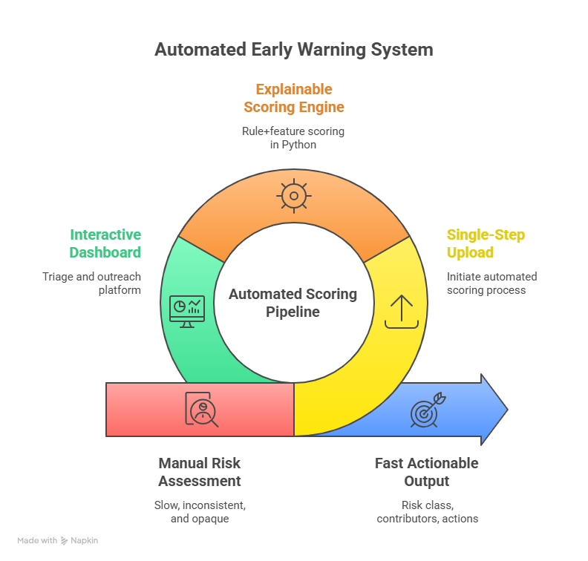
Proposed Solution
Implement a 3-Layer Early Warning System
Upload CSVs and the backend scores each account row-by-row using our scoring engine.
Each account gets a normalized risk_score (0–1), a risk_class (Low/Medium/High) and top-3 contributors.
The dashboard shows portfolio KPIs, feature averages, and a customer drawer with clear outreach actions.
The output is designed for operations teams — precise, explainable, and production-ready.

Slide 14
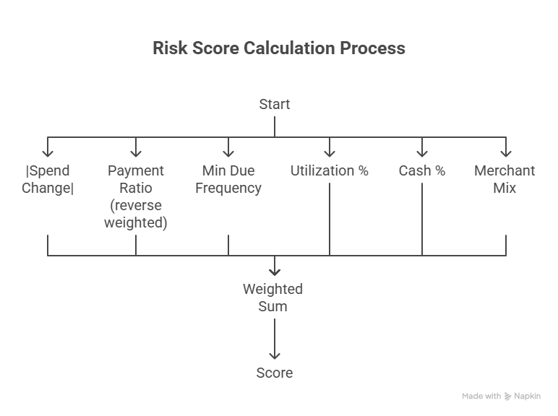
Scoring Engine Logic

Slide 15
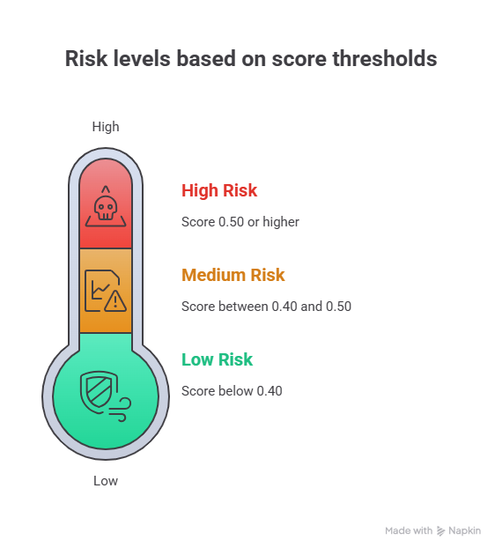
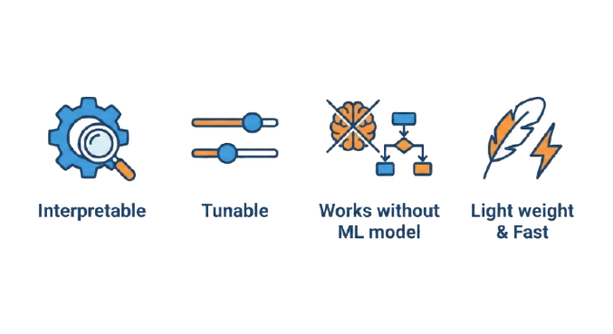
Risk Classification
Risk Levels Based on Score Thresholds

Slide 16
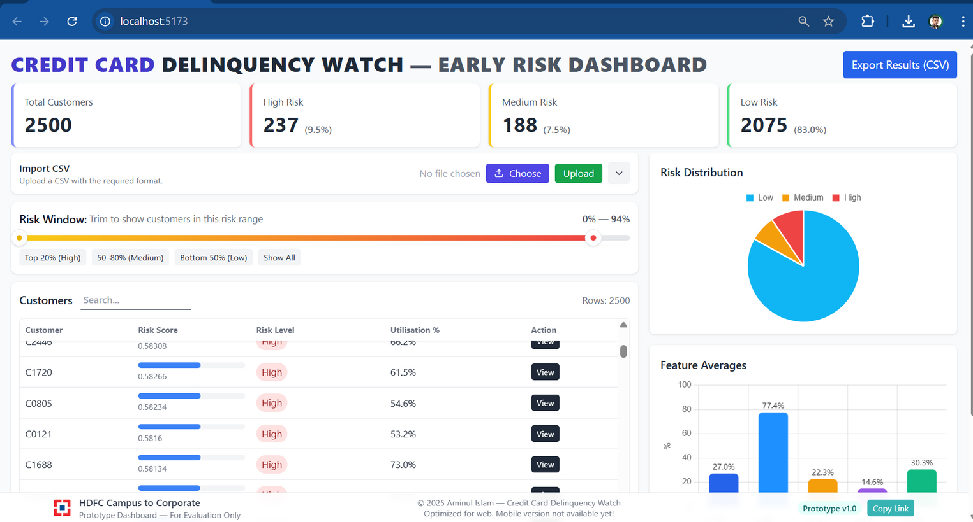
Dashboard Demo

Slide 17
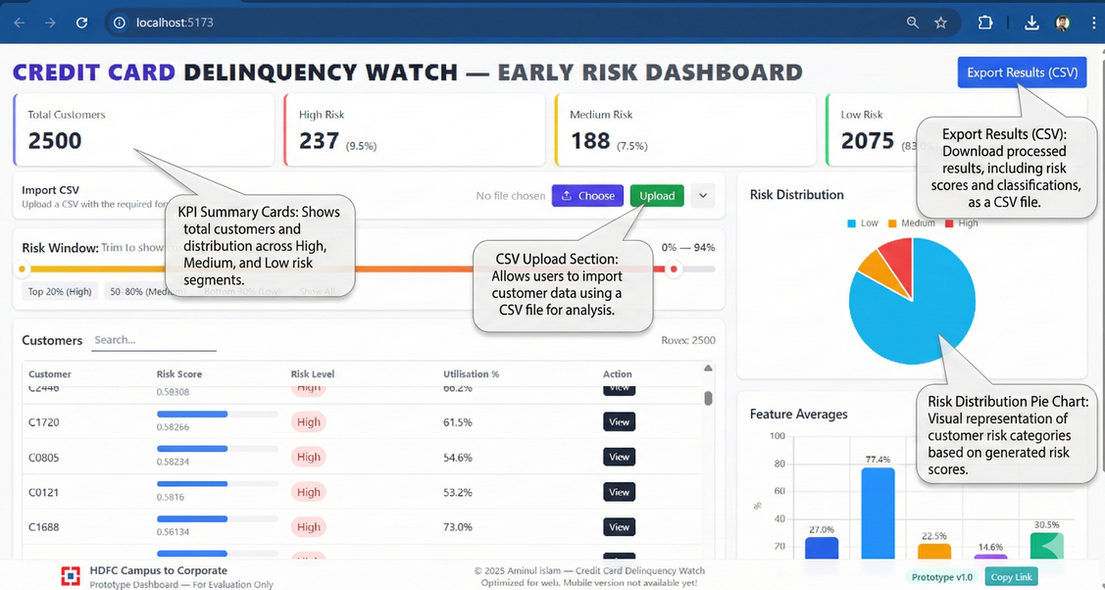
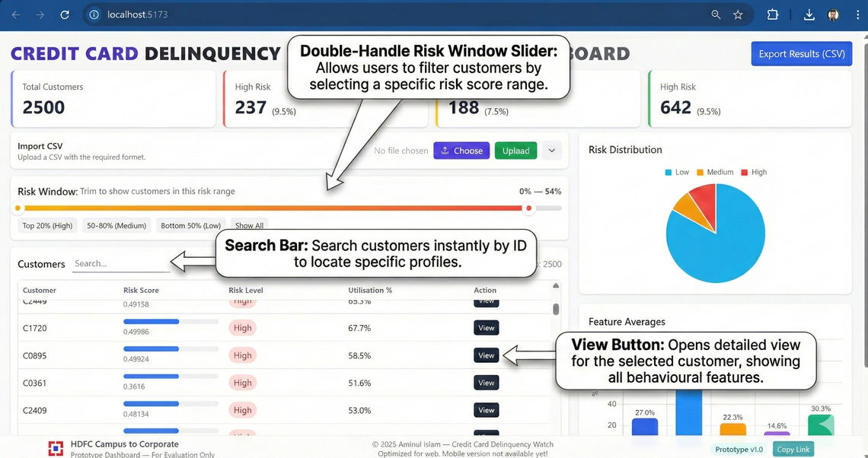
Dashboard Demo

Slide 18
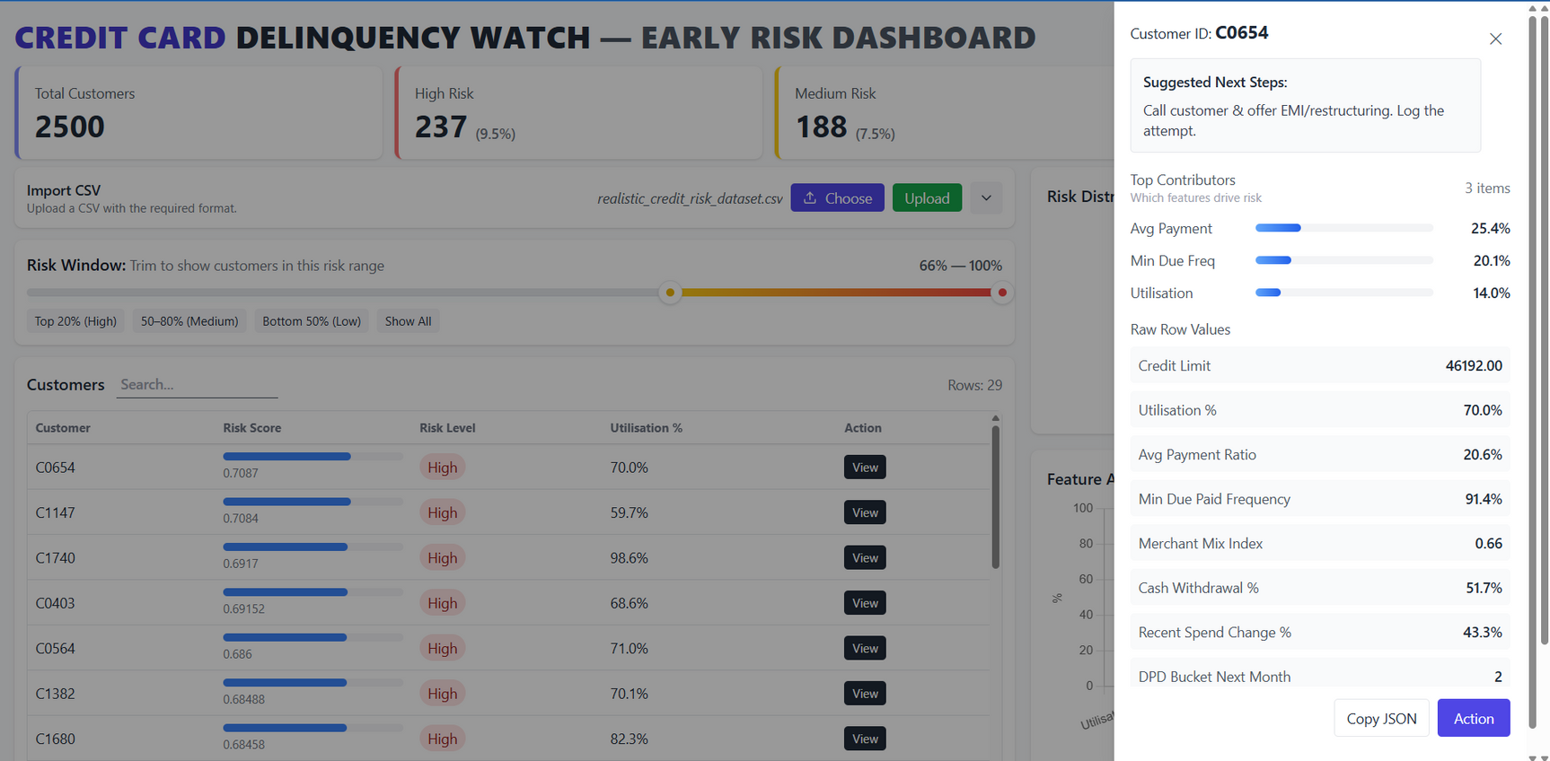
Dashboard Demo
Customer View Drawer

Slide 19
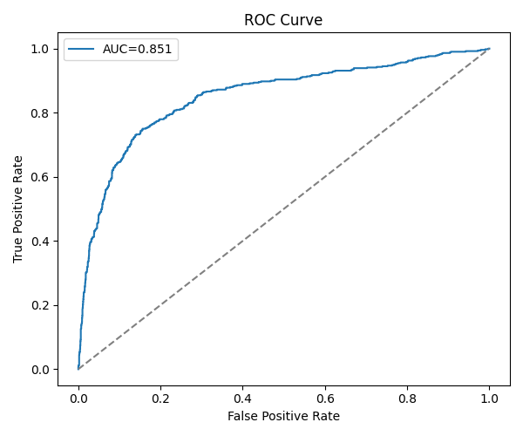
Model Evaluation
From evaluation:
Dataset: 2,500 customers (508 delinquent, 1,992 non-delinquent)
Accuracy: 85%
Precision: 78% (High Risk class)
AUC: 0.85
Catches 185 actual delinquents as High Risk
Strong ability to identify truly safe customers (97% correct)

Slide 20
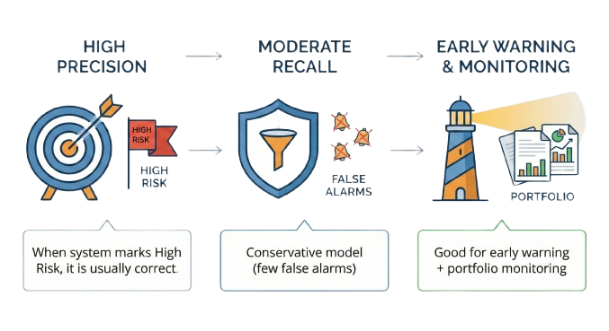
Interpreting Results

Slide 21
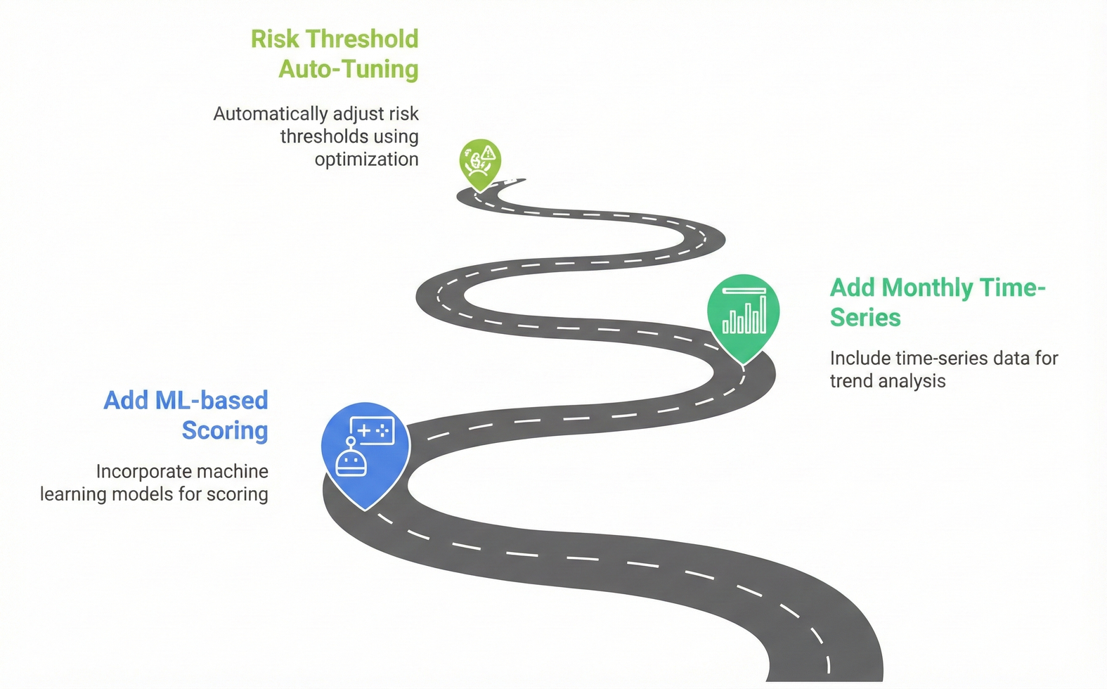
Feature Improvements

Slide 22
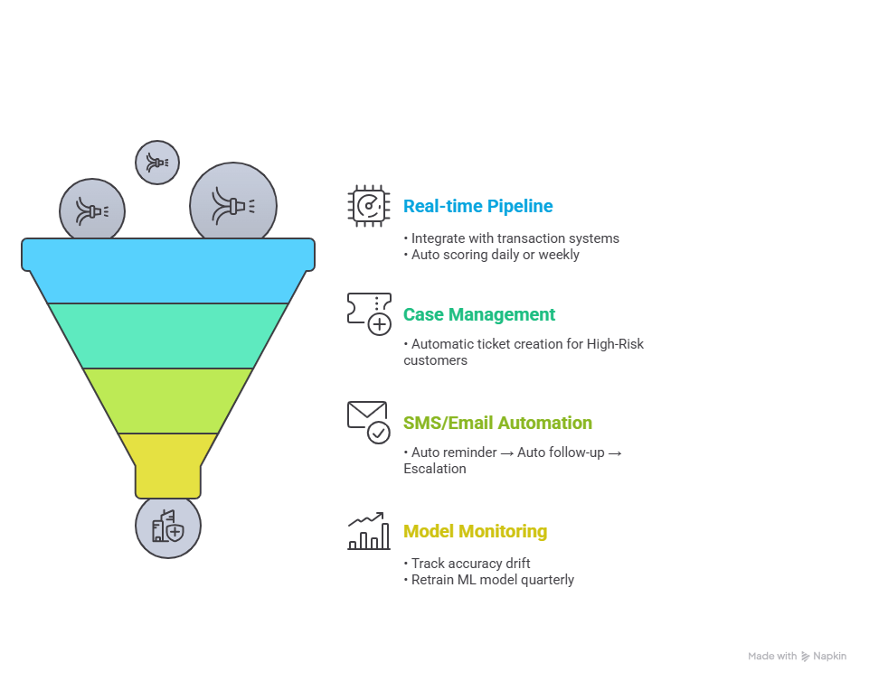
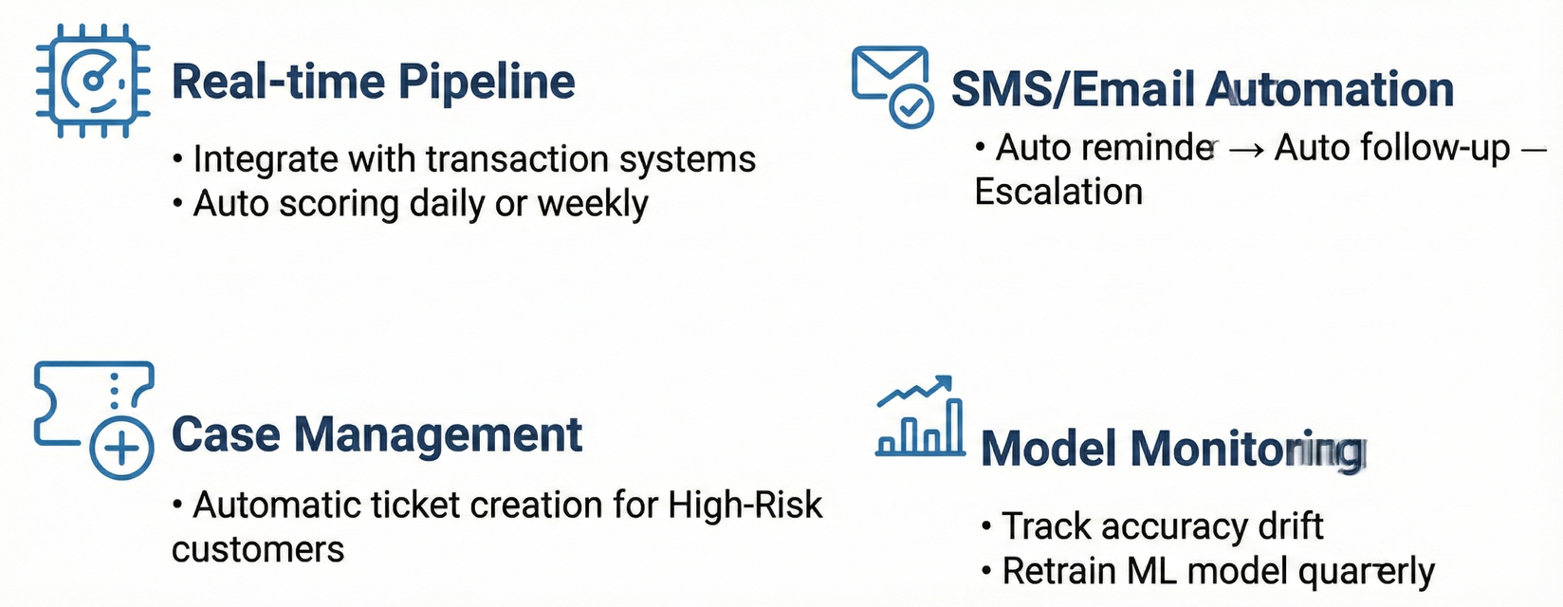
Scaling to Real Banking Environment

Slide 23

Conclusion
Built a fully working end-to-end early-warning system
Clean UI + explainability + actionable insights
Helps reduce delinquency and improve collections
Ready for next stage: ML model integration

Slide 24
Thank You
Submitted by :
Aminul Islam
Gauhati University
Thank you for reviewing my submission.
HDFC Campus to Corporate

